Slide 1

PYTHON
By Buddhadeb Koner
Chat GPT 3.5

Slide 2
String manipulation .............................................................
Lists & tuples ........................................................................
Dictionaries and sets ...........................................................
Loops (for and while) ...........................................................
Functions ..............................................................................
Recursion ..............................................................................
Conditionals (if statements) ................................................
Input and Output (printing, input function) ......................
File handling .........................................................................
Exception handling (try-except blocks) ..............................
Classes and objects .............................................................
Modules and packages .......................................................
List comprehensions ...........................................................
Lambda functions ................................................................
Generators and iterators ....................................................
Regular expressions ............................................................
CHAPTER’S

Slide 3
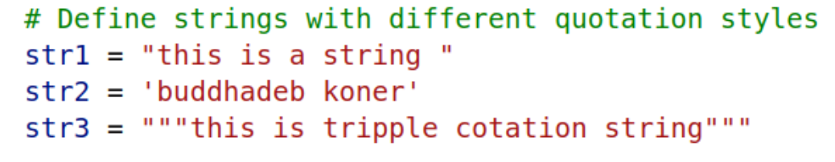
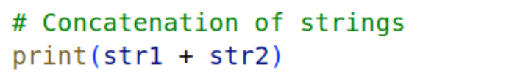
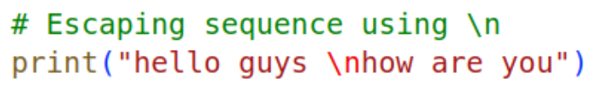
STRING MANUPULATION
Our First Program
Define strings with different quotation styles
print(“hello world”)
console
hello world
Define strings with different quotation styles
Escep Sequence \n
console
console
hello guys
How are you
this is a string buddhadeb koner

Slide 4
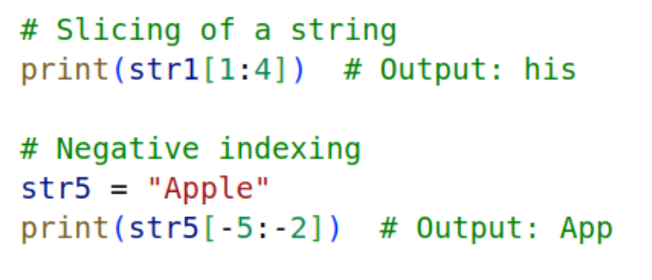
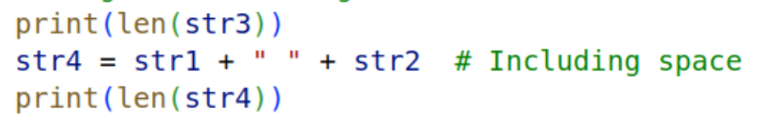
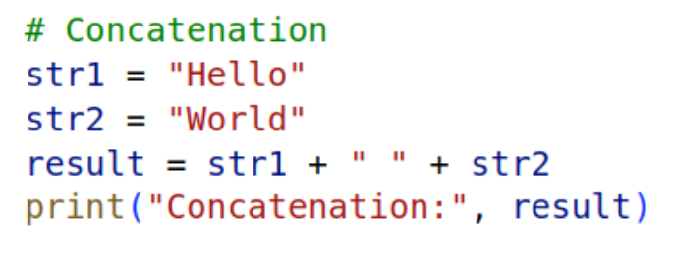
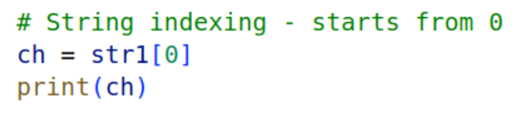
STRING MANUPULATION
Slicing
Length of a string
console
String Concatenation
31
32
String indexing
console
t
console
Hello World

Slide 5
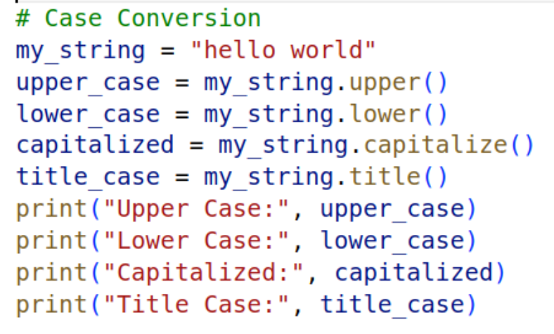
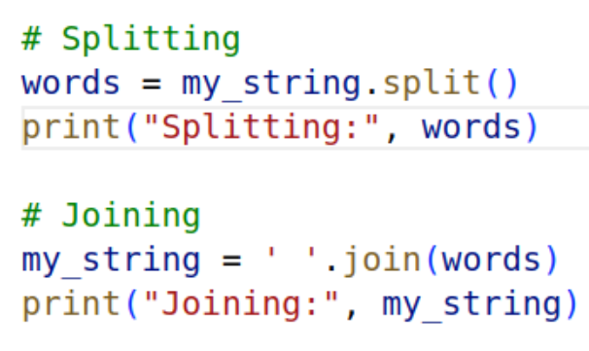
STRING MANUPULATION
Case Conversion
Splitting & Joining
console
console
Splitting: ['Hello', 'World']
Joining: Hello World
HELLO WORLD
hello world
Hello world
Hello World

Slide 6
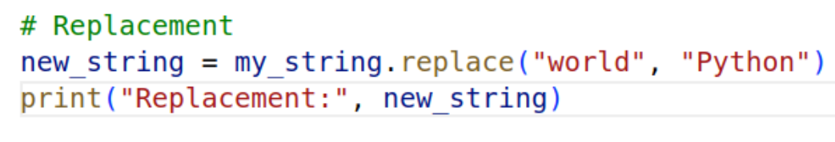
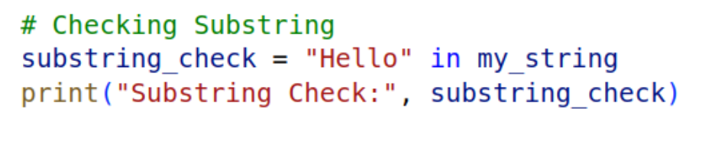
STRING MANUPULATION
Replacement
console
hello Python
Checking Substring
console
True

Slide 7
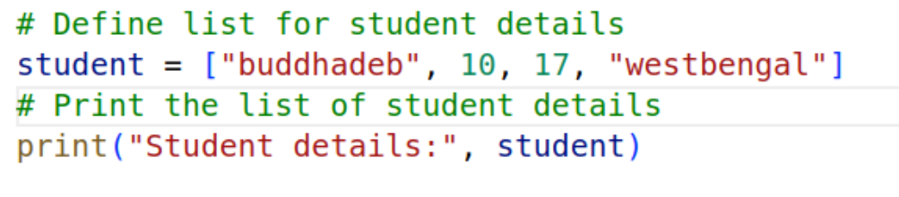
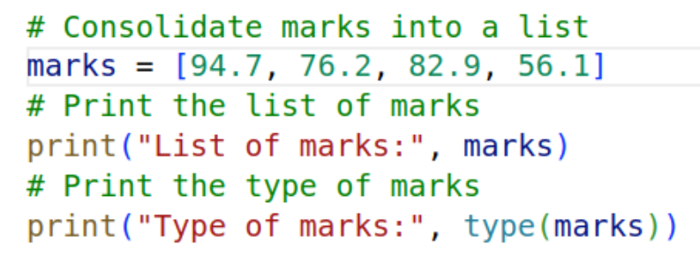
LIST & TUPPLE
Here you can see a difference between string and list
In Python, strings are immutable, so you cannot directly modify individual characters
str = 'hello'
str[4] = 'y' This is not possible
But in lists, you can modify individual elements
List of marks
Can Containing Different dataTypes
console
Student details: ['buddhadeb', 10, 17, 'westbengal']
console
List of marks: [94.7, 76.2, 82.9, 56.1]
Type of marks: <class 'list'>

Slide 8
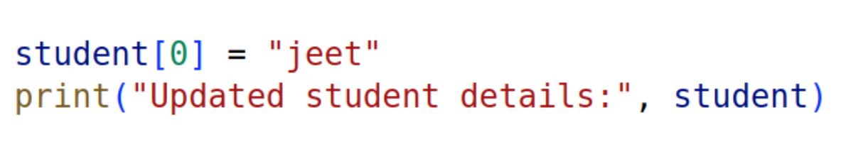
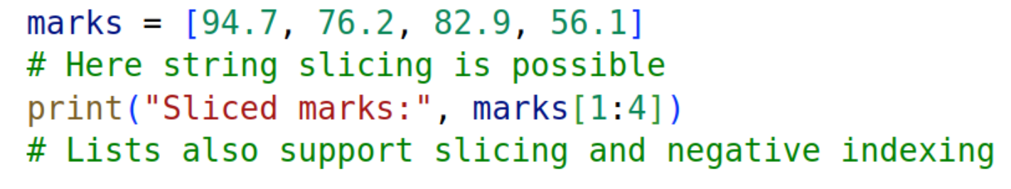
LIST & TUPPLE
Immutable List
Slicing List
console
console
Updated student details: ['jeet', 10, 17, 'westbengal']
Sliced marks: [76.2, 82.9, 56.1]
One main fact about lists in Python is that they are mutable, meaning you can change, add, or remove elements after the list has been created.

Slide 9
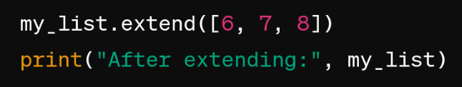
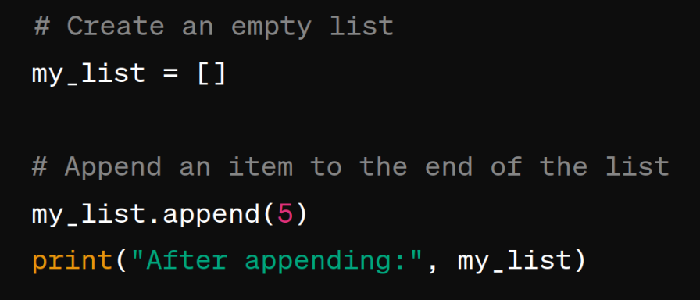
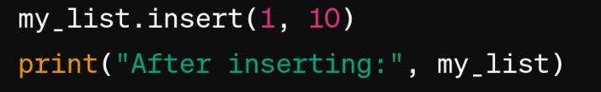
LIST & TUPPLE
Extend List
Append List
console
After extending: [6, 7, 8]
Insert List
console
After appending: [5]
console
Two arguments: (index & element)
Here 1 is the index and 10 will be the insert element
After inserting: [5, 10, 6, 7, 8]

Slide 10
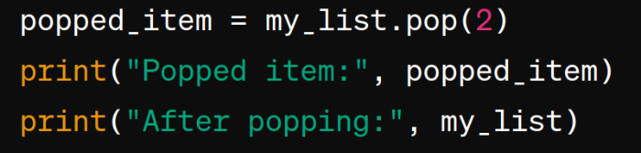
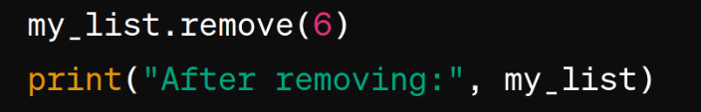
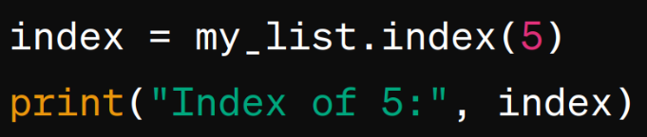
LIST & TUPPLE
Pop Element List
List Methods
Remove element from List
console
console
Popped item: 7
After popping: [5, 10, 8]
After removing: [5, 10, 7, 8]
6 is not present in this list
It will take one argumenet that is the element which you wanna remeove
It will take one argument that is index ,
Wich index you want to poped, it will return the poped element
Find index of an Element in List
console
Index of 5: 0

Slide 11
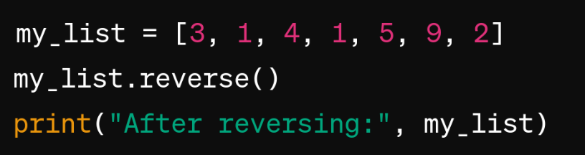
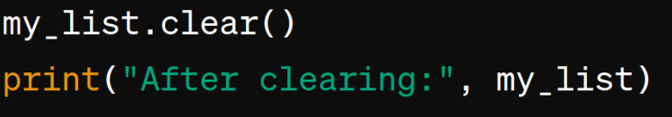
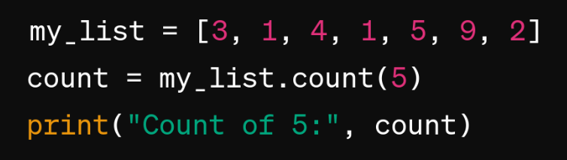
LIST & TUPPLE
Reverse List
List Methods
Clear List
console
console
After reversing: [2, 9, 5, 1, 4, 1, 3]
After Clearing: [ ]
It will chage the original List , if you do like this
result = my_list.reverse() {nothing to return}
Here result is none & my_list reversed the list
Count of a particular Element
console
Count of 5: 1

Slide 12
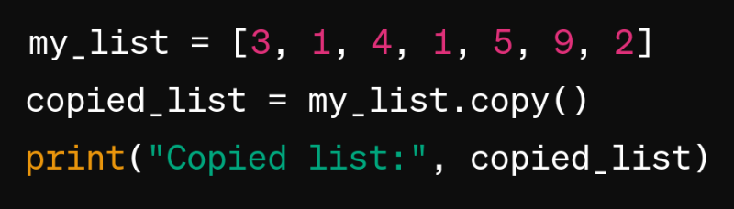
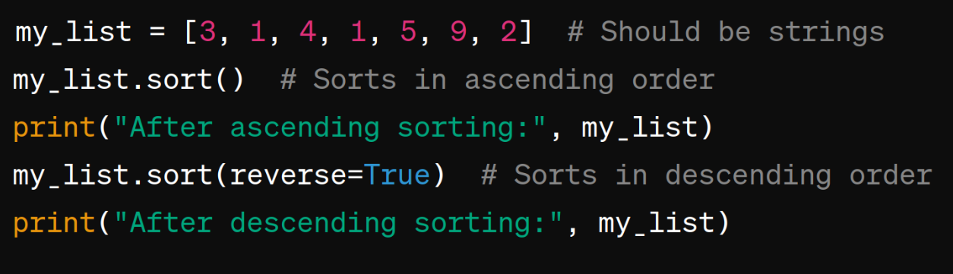
LIST & TUPPLE
List Methods
Shallow copy List
Sorting of List
console
Copied list: [3, 1, 4, 1, 5, 9, 2]
console
It will return shallow copy Both original_list and copied_list will contain references to the same nested lists. If you modify a nested list in original_list, the corresponding nested list in copied_list will also be modified, and vice versa.
After ascending sorting: [1, 1, 2, 3, 4, 5, 9]
After descending sorting: [9, 5, 4, 3, 2, 1, 1]
Same here it will change in the original list, return nothing.

Slide 13
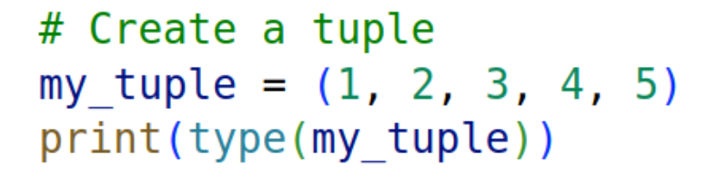
LIST & TUPPLE
Tupple Methods
While tuples and lists share many similar methods, it's important to note that tuples are immutable, meaning once created, their elements cannot be changed. As a result, methods that modify the structure of the tuple, such as append(), remove(), and pop(), are not applicable to tuples. However, tuple methods like count() and index() are indeed available and operate similarly to their list counterparts, providing essential functionality for working with immutable collections.
Tuples are immutable in Python, so focus on methods like count() and index() rather than those that modify the tuple structure.
Making Tupple
console
<class 'tuple'>

Slide 14
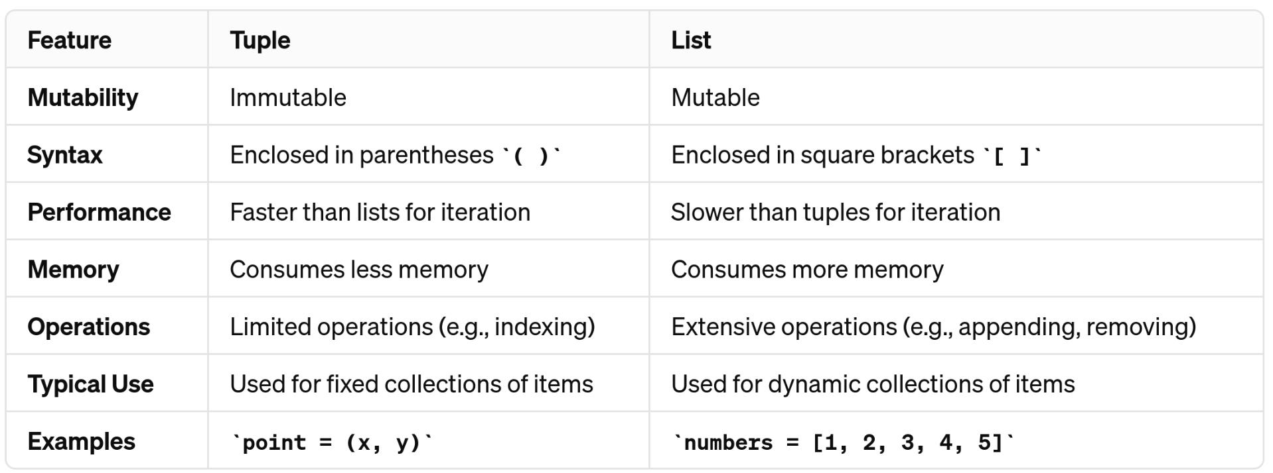
LIST & TUPPLE
Different Between Tupple & List

Slide 15
CHAPTER’S

Slide 16
CHAPTER’S

Slide 17
CHAPTER’S

Slide 18
CHAPTER’S

Slide 19
CHAPTER’S

Slide 20
THANK YOU
By Buddhadeb Koner
Chat Gpt

